Slide 1
Lending Case Study
Sunita Saraf
Shivananda Reddy

Slide 2
Objective
The objective of this case study is to identify risky loan applicants (lending loans) as it is financial loss to company, if such a loan can be reduced then it ultimately results in cutting down the amount of credit loss to company.
Benefits of case study:
Gives idea about how EDA is used in real life problems.
It also develops basic understanding of risk analysis
It improves our understanding of visualization and how charts to use in data.
How data is used to minimize loss in business.

Slide 3
Objective
The Objective of this case study is to implement EDA technique on a real world problem and understand the insights and present in a business first manner via presentation.
Benefits of the case study:
Gives a idea about how EDA is used in real life business problems.
It also develops a basic understanding of risk analytics in banking and financial services.
How the data is used to minimize loss of money while lending it to clients.
It improves our understating of visualization and what charts to use for real life data.

Slide 4
Business Understanding
The business objective is to take a decision whenever they receive a loan application whether to reject or approve based on certain variables.
Dataset Details:
The data given below contains information about past loan applicants and whether they ‘defaulted’ or not. Data has details regarding approved loan not the rejected ones. It has 3 status of loan which is Fully Paid, Current and Charged-Off.
Data Clean-up and preparation process:
Importing the Data
Removing large null value columns
Removing irrelevant columns
Removing/Fixing null values
Correcting data types
Filter Data as per the requirement.
Removing Duplicate Data
Removing outliers

Slide 5
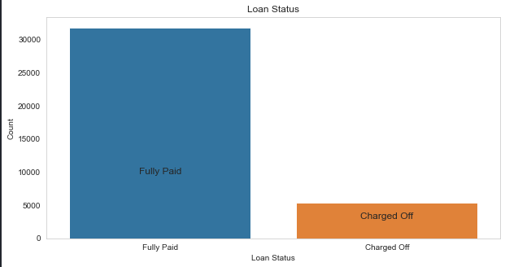
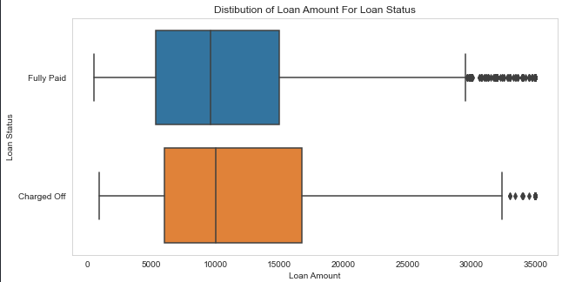
Loan Status and Amount
The number of charged off loan is much smaller compared to total count.
Larger loan amount goes with higher chance of defaulting.

Slide 6
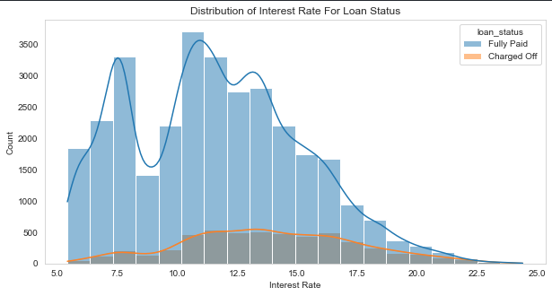
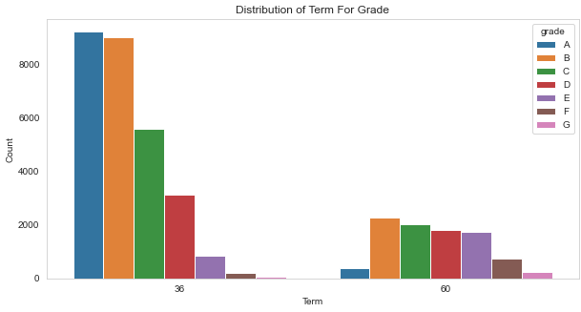
Interest Rate
Grade
The count of loan taken varies with interest rate showing peak around in 5-15 bracket and decreasing slowly where as the chance of defaulting increases with interest rate.
60 month term loans have larger number of lower grade loans with high risk.
60 month term loans have larger number of lower grade loans with high risk.

Slide 7
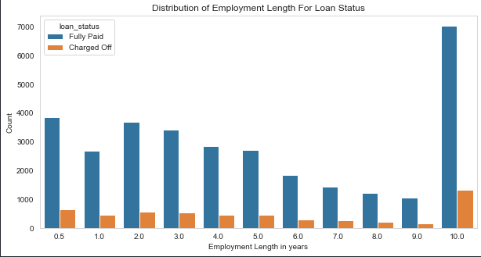
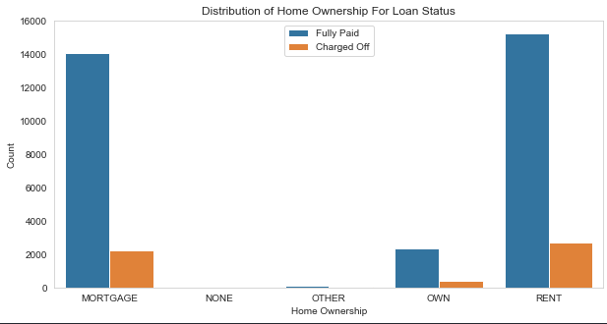
Employment Length & Homeownership
Majority of clients have 10+ years of experience and has highest number of defaulted loan.
Majority of clients are lacking ownership of any property and are on rent or mortgage and have a higher chance of defaulting.

Slide 8
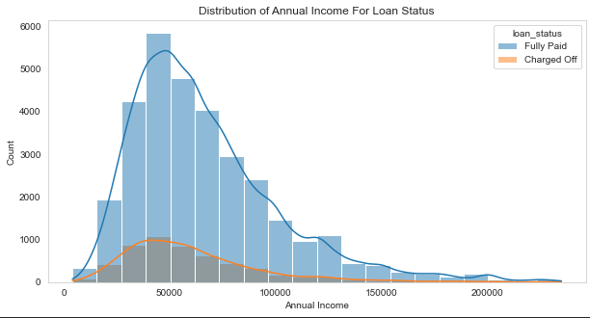
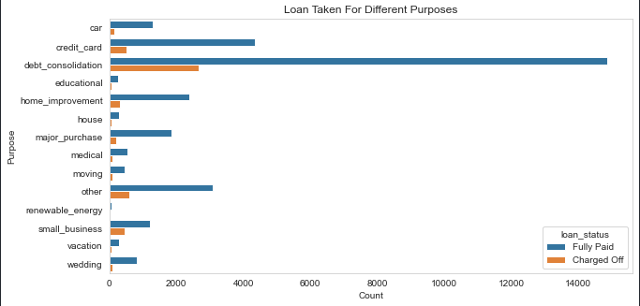
Annual Income & Purpose
The Majority of clients have low annual income compared to rest and income lower than 50k has higher chance of defaulting.
Loans are taken mostly for debt consolidation followed by credit card payment. Whereas the debt consolidation has highest fully paid loan but also has highest defaulted loans as well.

Slide 9
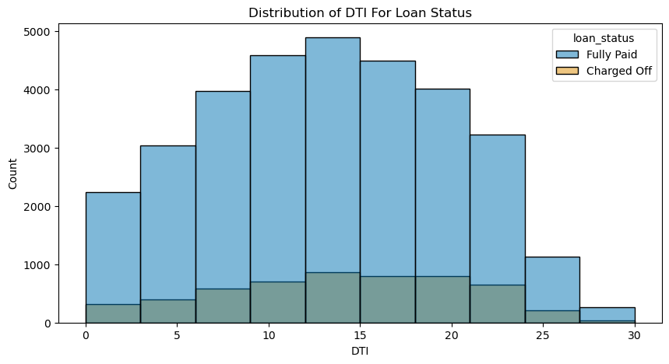
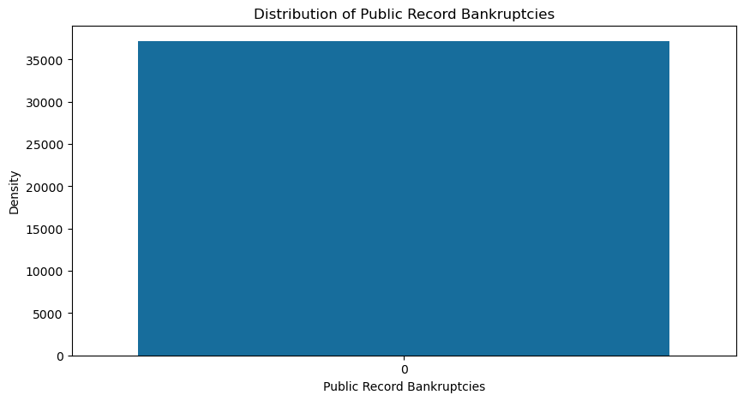
DTI ratio & Bankruptcy
The large percentage of Clients have a large Debt to Income ratio which shows that lending to such clients can be very risky.
Majority of clients have no record of declaring bankruptcy.

Slide 10
Recommendations
Recommendations
Major Driving factor which can be used to predict the chance of defaulting and avoiding Credit Loss:
1. DTI 2. Grades 3. Verification Status 4. Annual income 5. Pub_rec_bankruptcies
Below are the Observation for 'defaults' :
1. The Employees with 10+ years of experience are likely to default and have higher chance of fully paying the loan.
2. we can say that higher grade has lower rate of default.
3. Borrowers with less 50000 annual income are more likely to default and higher annual income are less likely to default.
4. 60 month term has higher chance of defaulting than 36 month term whereas the 36 month term has higher chance of fully paid loan.
5. The annual income of customers who have fully paid the loan is higher than the defaulters.
6. DTI is slightly higher in defaulters than the fully paid.
7. Large percentage of loans are taken for debt consolidation followed by credit card and other.
8. The borrowers have no record of Public Recorded Bankruptcy and are safe choice for loan issue.
9. Burrowers with very high Debt to Income value.

